Slide 1
Titanic Data
Link : - https://www.kaggle.com/c/titanic

Slide 2
My learning through this project :
Grid Search is a very useful weapon.
Decision Tree And Random Forest Both are Very Good For That Data
Logistic Is Give High Accuracy

Slide 3
Goal
To predict if a passenger survived the sinking of the Titanic or not. For each in the test set, we must predict a 0 or 1 value for the variable.
Metric
My score is the percentage of passengers you correctly predict. This is known as accuracy

Slide 4
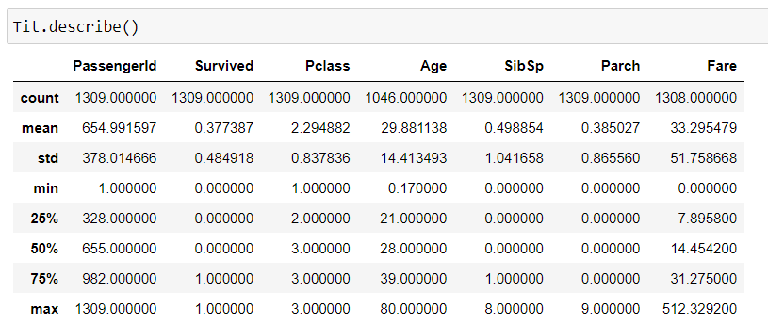
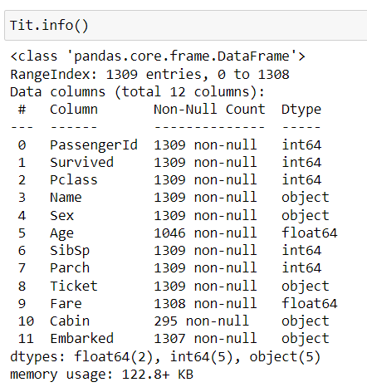
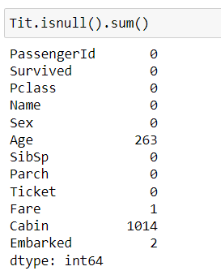
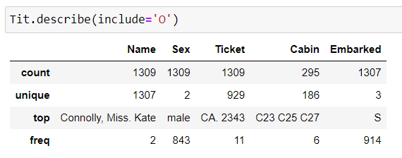

Data Inspection

Slide 5
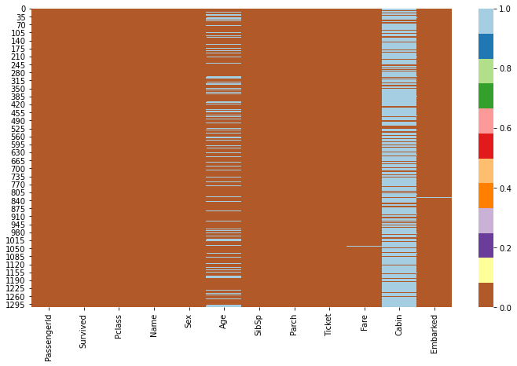
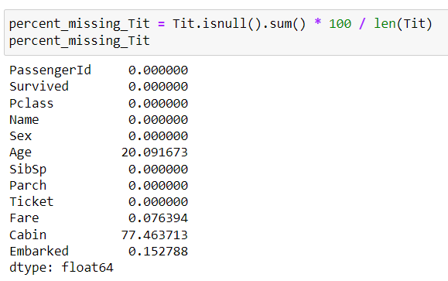
Heat Map

Slide 6
Data cleaning
PassengerId is unique for whole data
Also name is unique
As Per name Ticket is also unique for every passenger
And Last Cabin is 77.5 % Null Values
So that We Can’t Consider that columns for models

Slide 7
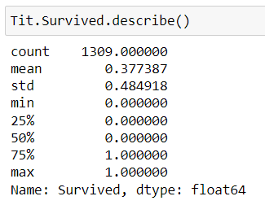
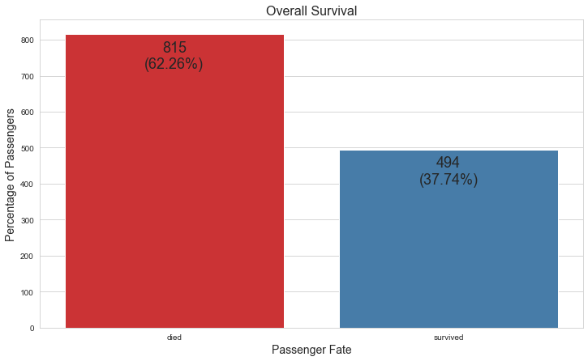
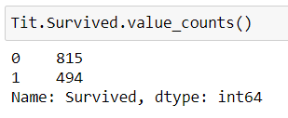
Survived (Response Variable)

Slide 8
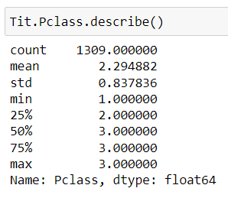
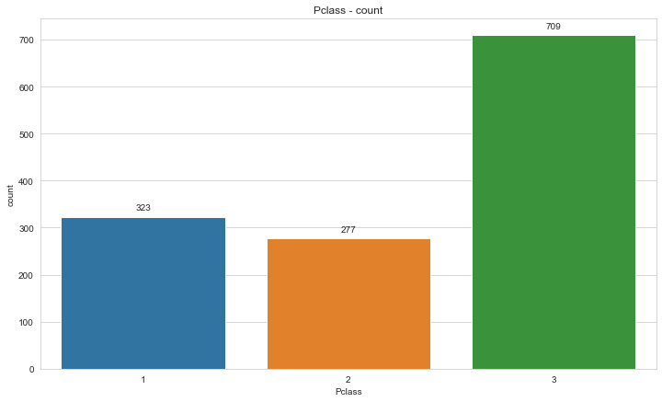
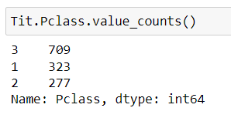
Pclass (Categorical Variable)

Slide 9
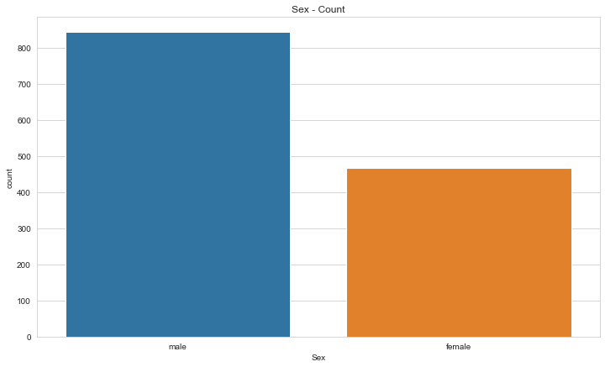
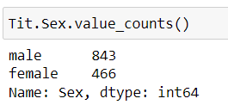
Sex (Categorical Variable)

Slide 10
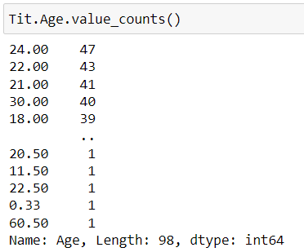

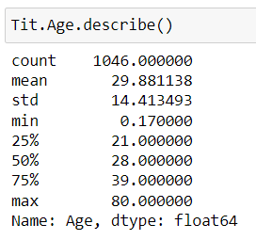
Age (Continuous Variable)

Slide 11
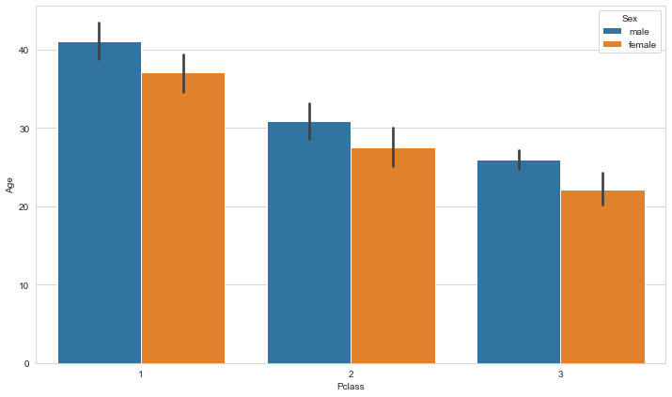
**We want to fill in missing age data instead of just dropping the missing age data rows.**
**One way to do this by filling in the mean age of all the passengers(imputation).**
**However we can be smarter about this and check the average age by PClass**

Slide 12
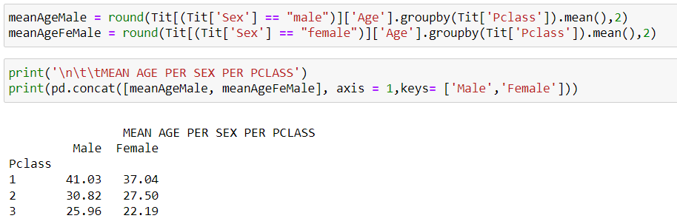
Find Values with respect to pClass

Slide 13
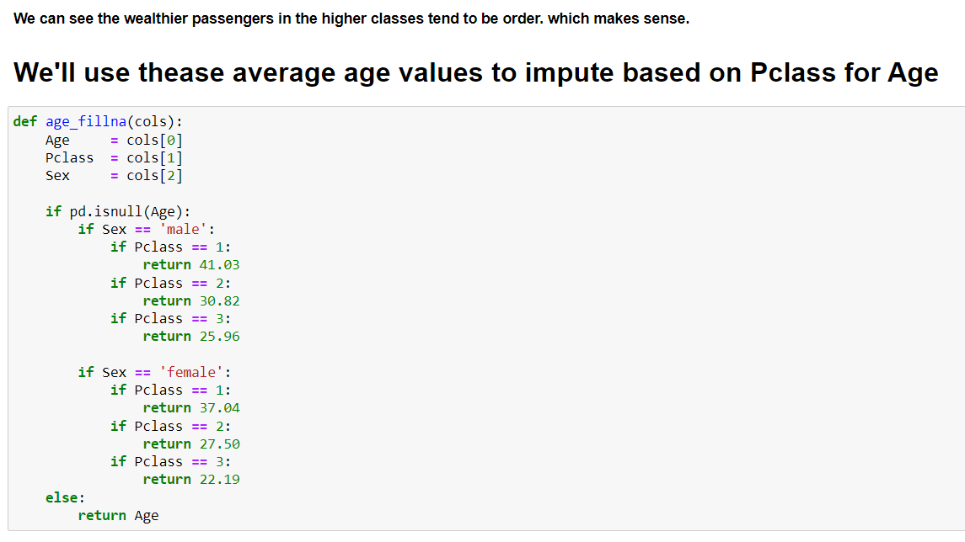
Feel Null with respect to pClass

Slide 14

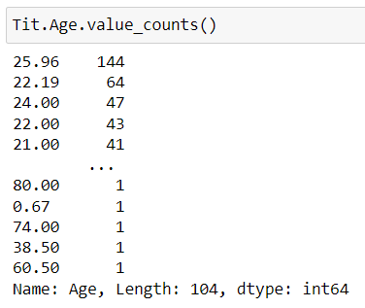
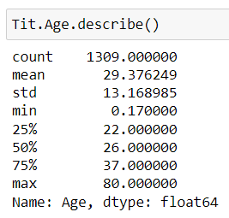

Slide 15
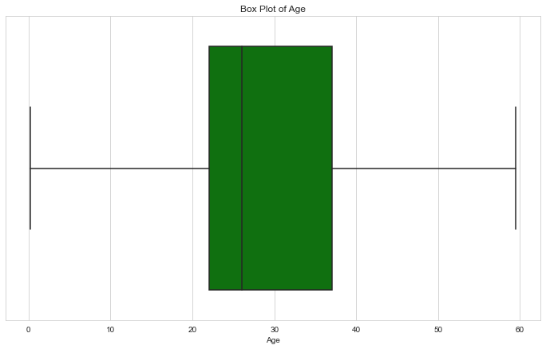
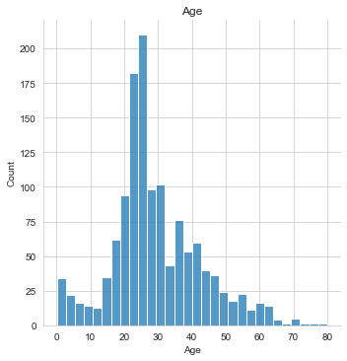
* Few outliers are there, treatment was done

Slide 16
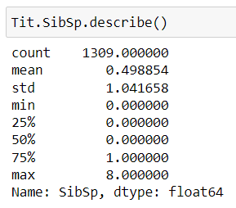
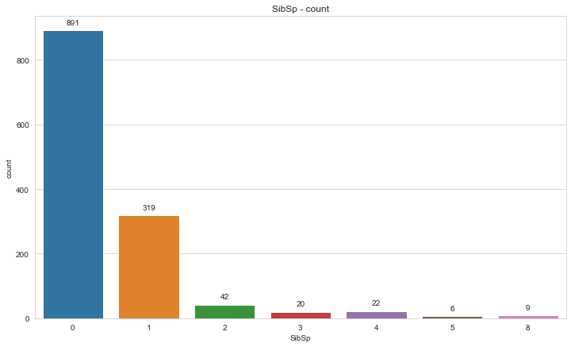
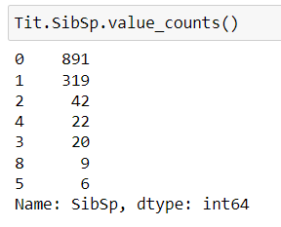
SibSp (Categorical Variable)

Slide 17
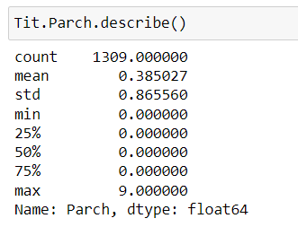
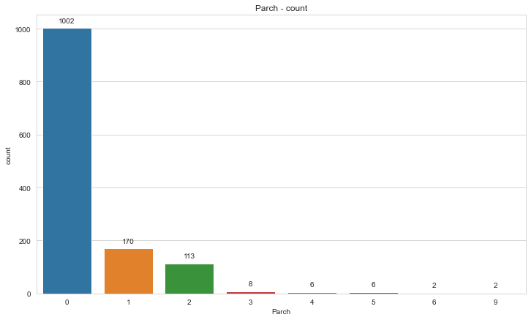
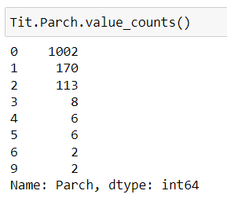
Parch (Categorical Variable)

Slide 18
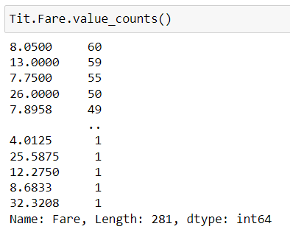

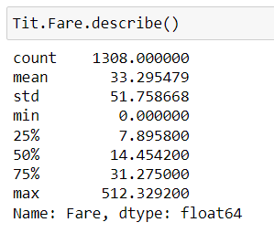
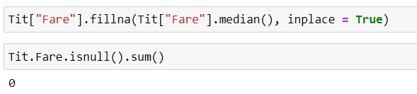
Fare (Continuous Variable)

Slide 19
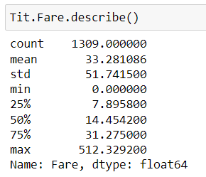
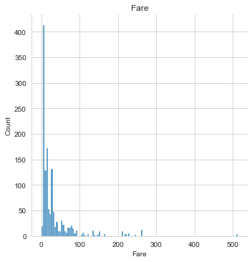
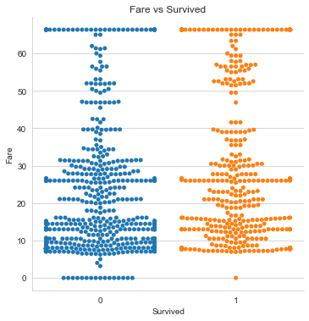
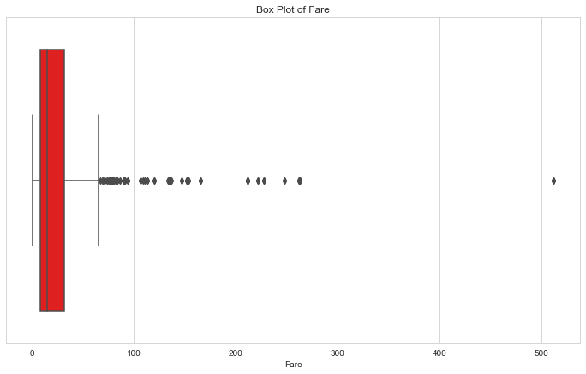
Histogram of Fare
catplot of Fare
Boxplot of Fare
* Few outliers are there, treatment was done

Slide 20
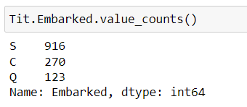

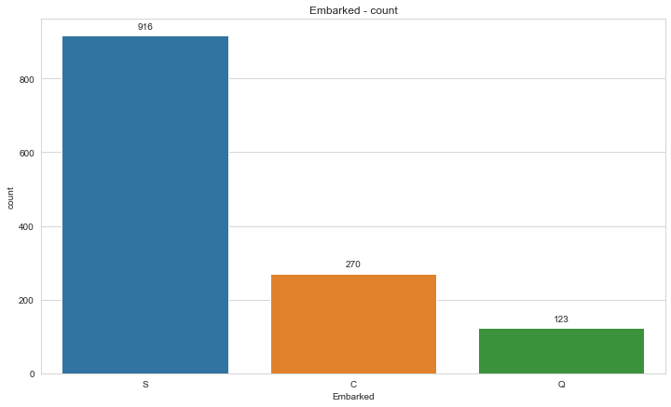
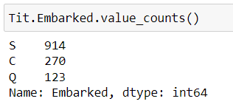
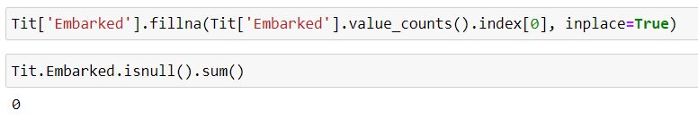
Embarked (Categorical Variable)

Slide 21
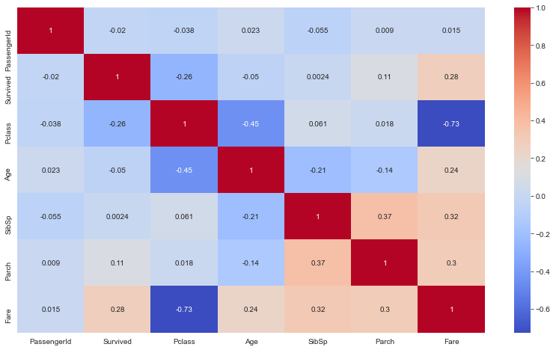
Heatmap(Correlation)

Slide 22
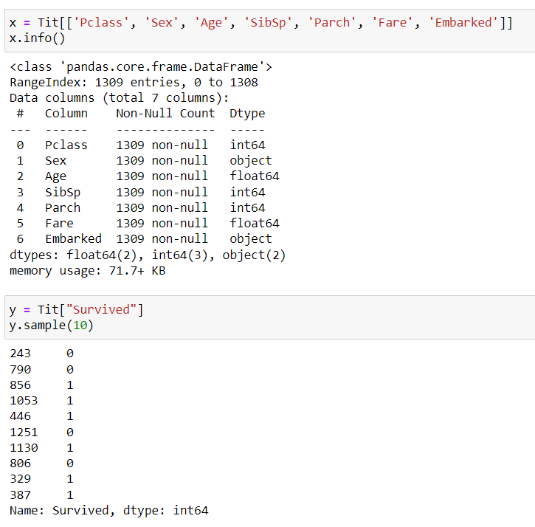
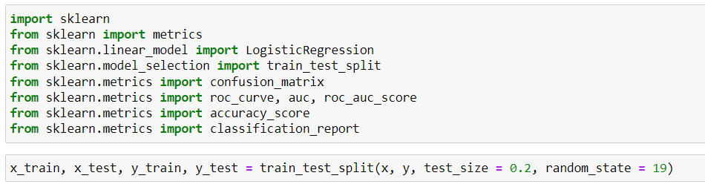
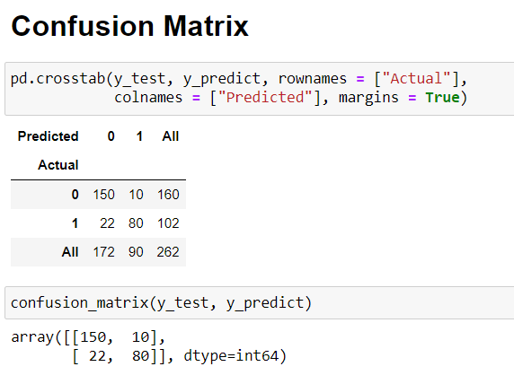
Model (Logistic Regression)

Slide 23
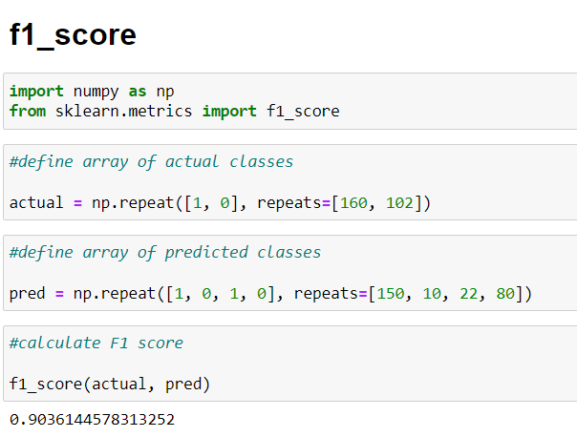
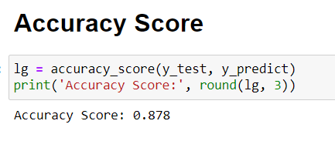
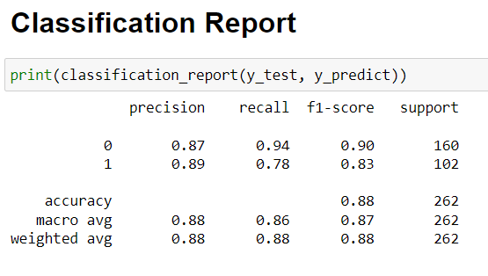

Slide 24
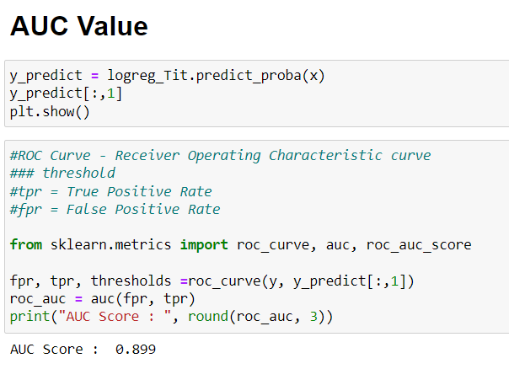
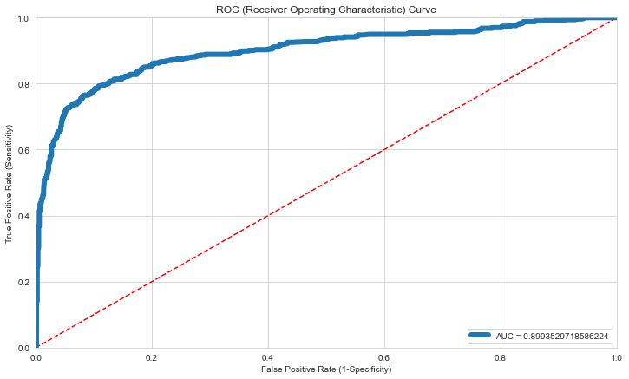
*Accuracy on test dataset is 0.878

Slide 25
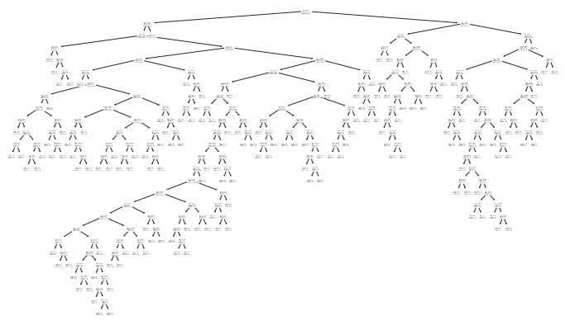



Model (Decision Tree)
CCP_alpha = 0.01

Slide 26



Model (Decision Tree)
CCP_alpha = 0.01
*Accuracy on test dataset is 0.86

Slide 27

Model (random forest)
CCP_alpha = 0.011
*Accuracy on test dataset is 0.877

Slide 28

Model (Ada Boosting)
*Accuracy on test dataset is 0.866

Slide 29

Model (XG Boosting)
*Accuracy on test dataset is 0.866

Slide 30

Accuracy of all the Models

Slide 31

Thank You

